Slide 1
Read this first
How to use this presentation
This presentation has been prepared by the Healthy Eating Advisory Service (HEAS) team for Health Promotion professionals to use when running professional development sessions. Please consider the following when using this presentation:
Slides 2-9 are included to present on the 'Nutrition in early childhood' topic. There are accompanying speaking notes that can be used. There is no expectation that these speaking notes are used, they are optional.
Slide 10 includes a video on the Five food groups.
Slide 11-13 are slides that can be used for discussion prompts. You can use some or all as required.
Slide 15 is a HEAS acknowledgment slide. Please feel free to also include your own closing slide.

Slide 2
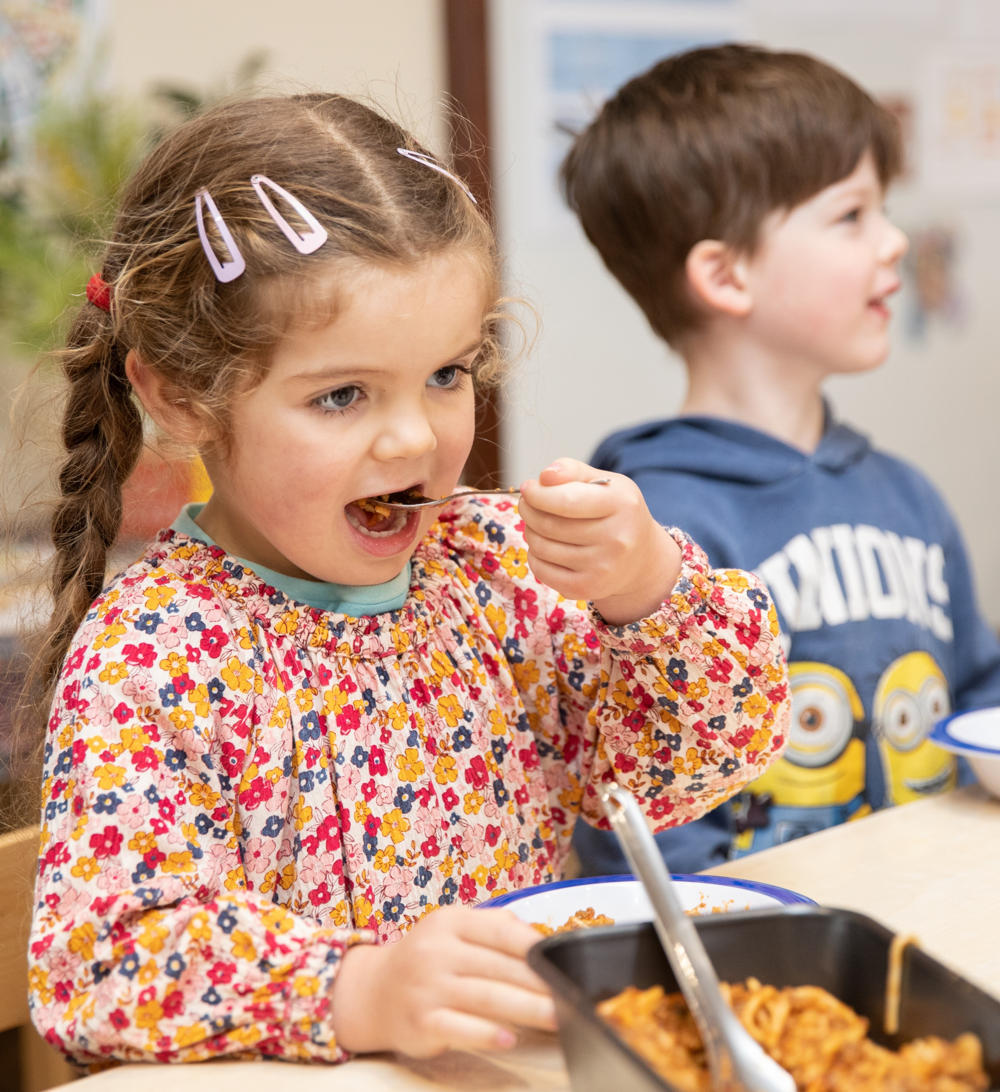

Nutrition in Early Childhood
Mini Professional Development

Slide 3
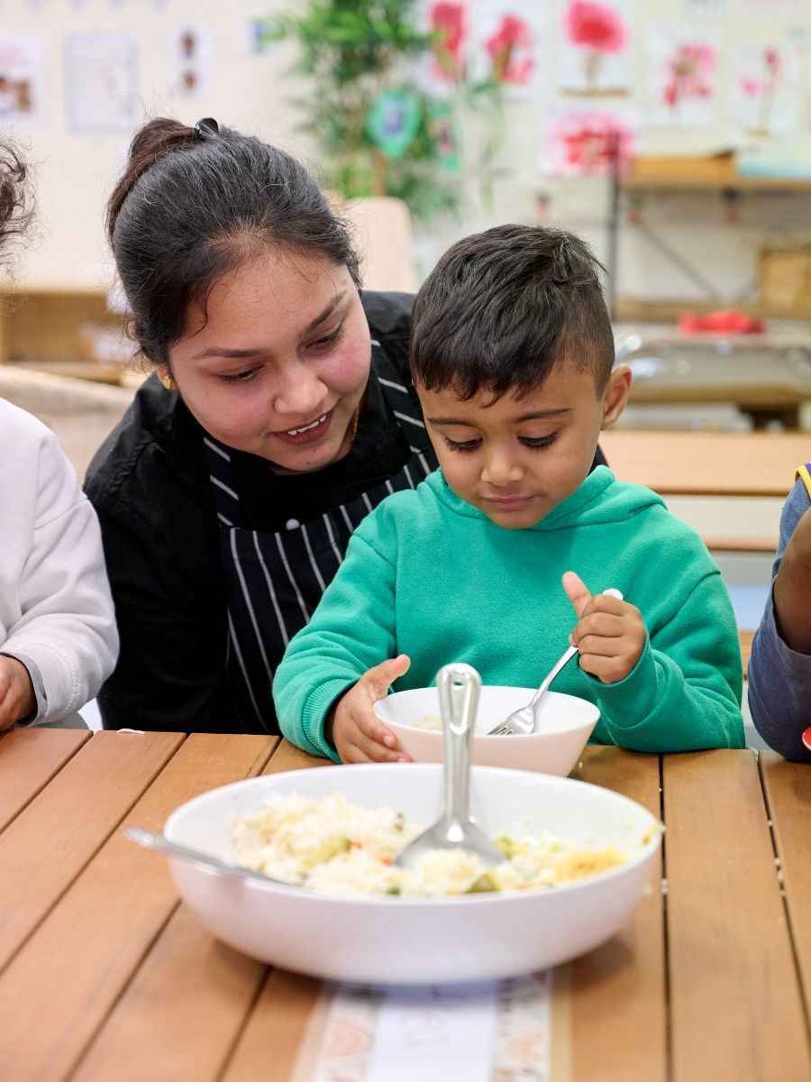
Learning Outcomes
Understand the importance of nutrition in the context of early childhood development
Understand how different nutrients impact growth and development
Learn practical strategies for menu planning and cooking to support a nutritious diet
Understand the ‘eat the rainbow’ approach to encourage dietary variety and nutritional intake

Slide 4

Importance of nutrition
    First 2000 days are when a child’s brain, body and immune system are developing faster than they ever will again.
    Good nutrition is important for energy to:
    Support growth and development
    Support concentration and learning
    Regulate their emotions
Early years is also an important time for developing food preferences and habits

Slide 5

Nutrition in childcare
    30+ hrs
    50-70%
    Time children spend in childcare each week
    Number of meals eaten in childcare each day
    Need to meet 50-70% of nutrition needs in childcare

Slide 6

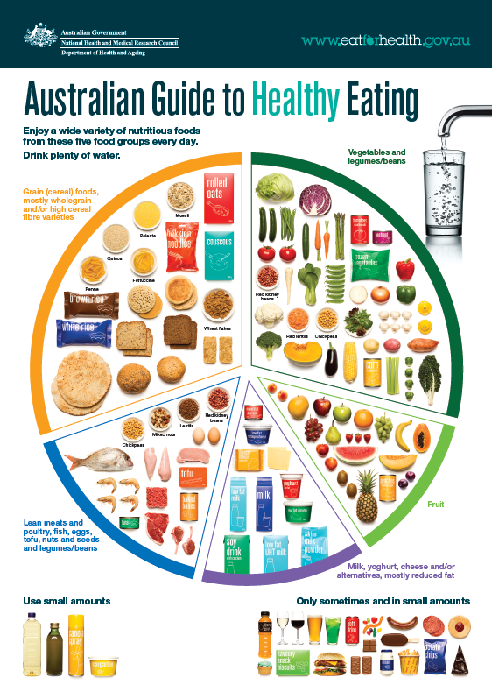
Australian Guide to Healthy Eating

Slide 7
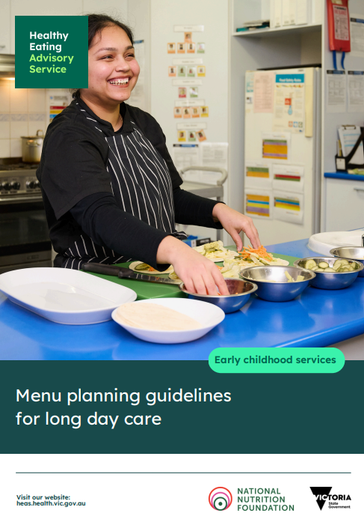

Menu Planning Guidelines
Based on Australian Dietary Guidelines
Help you plan a menu that provides 1–5-year-old children with half of their daily requirements
Includes:
Guideline outline
Ingredient quantity guide
Menu planning checklist
Links to other helpful resources

Slide 8
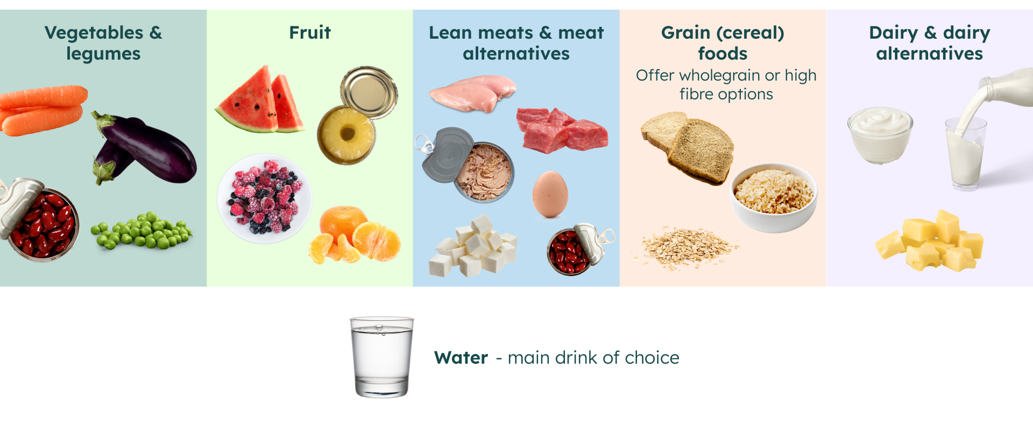
The five food groups

Slide 9
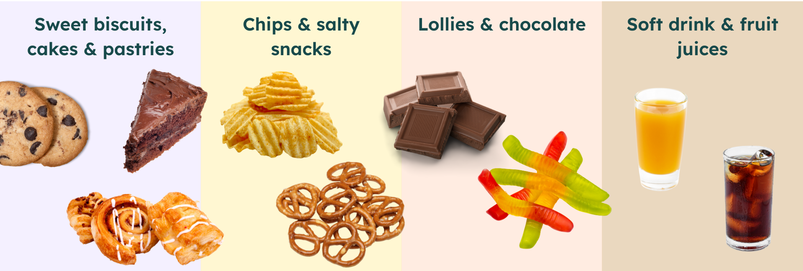
Foods not to include on the menu
Foods that are high in added sugars, saturated fats and salt

Slide 10



Five food groups video

Slide 11
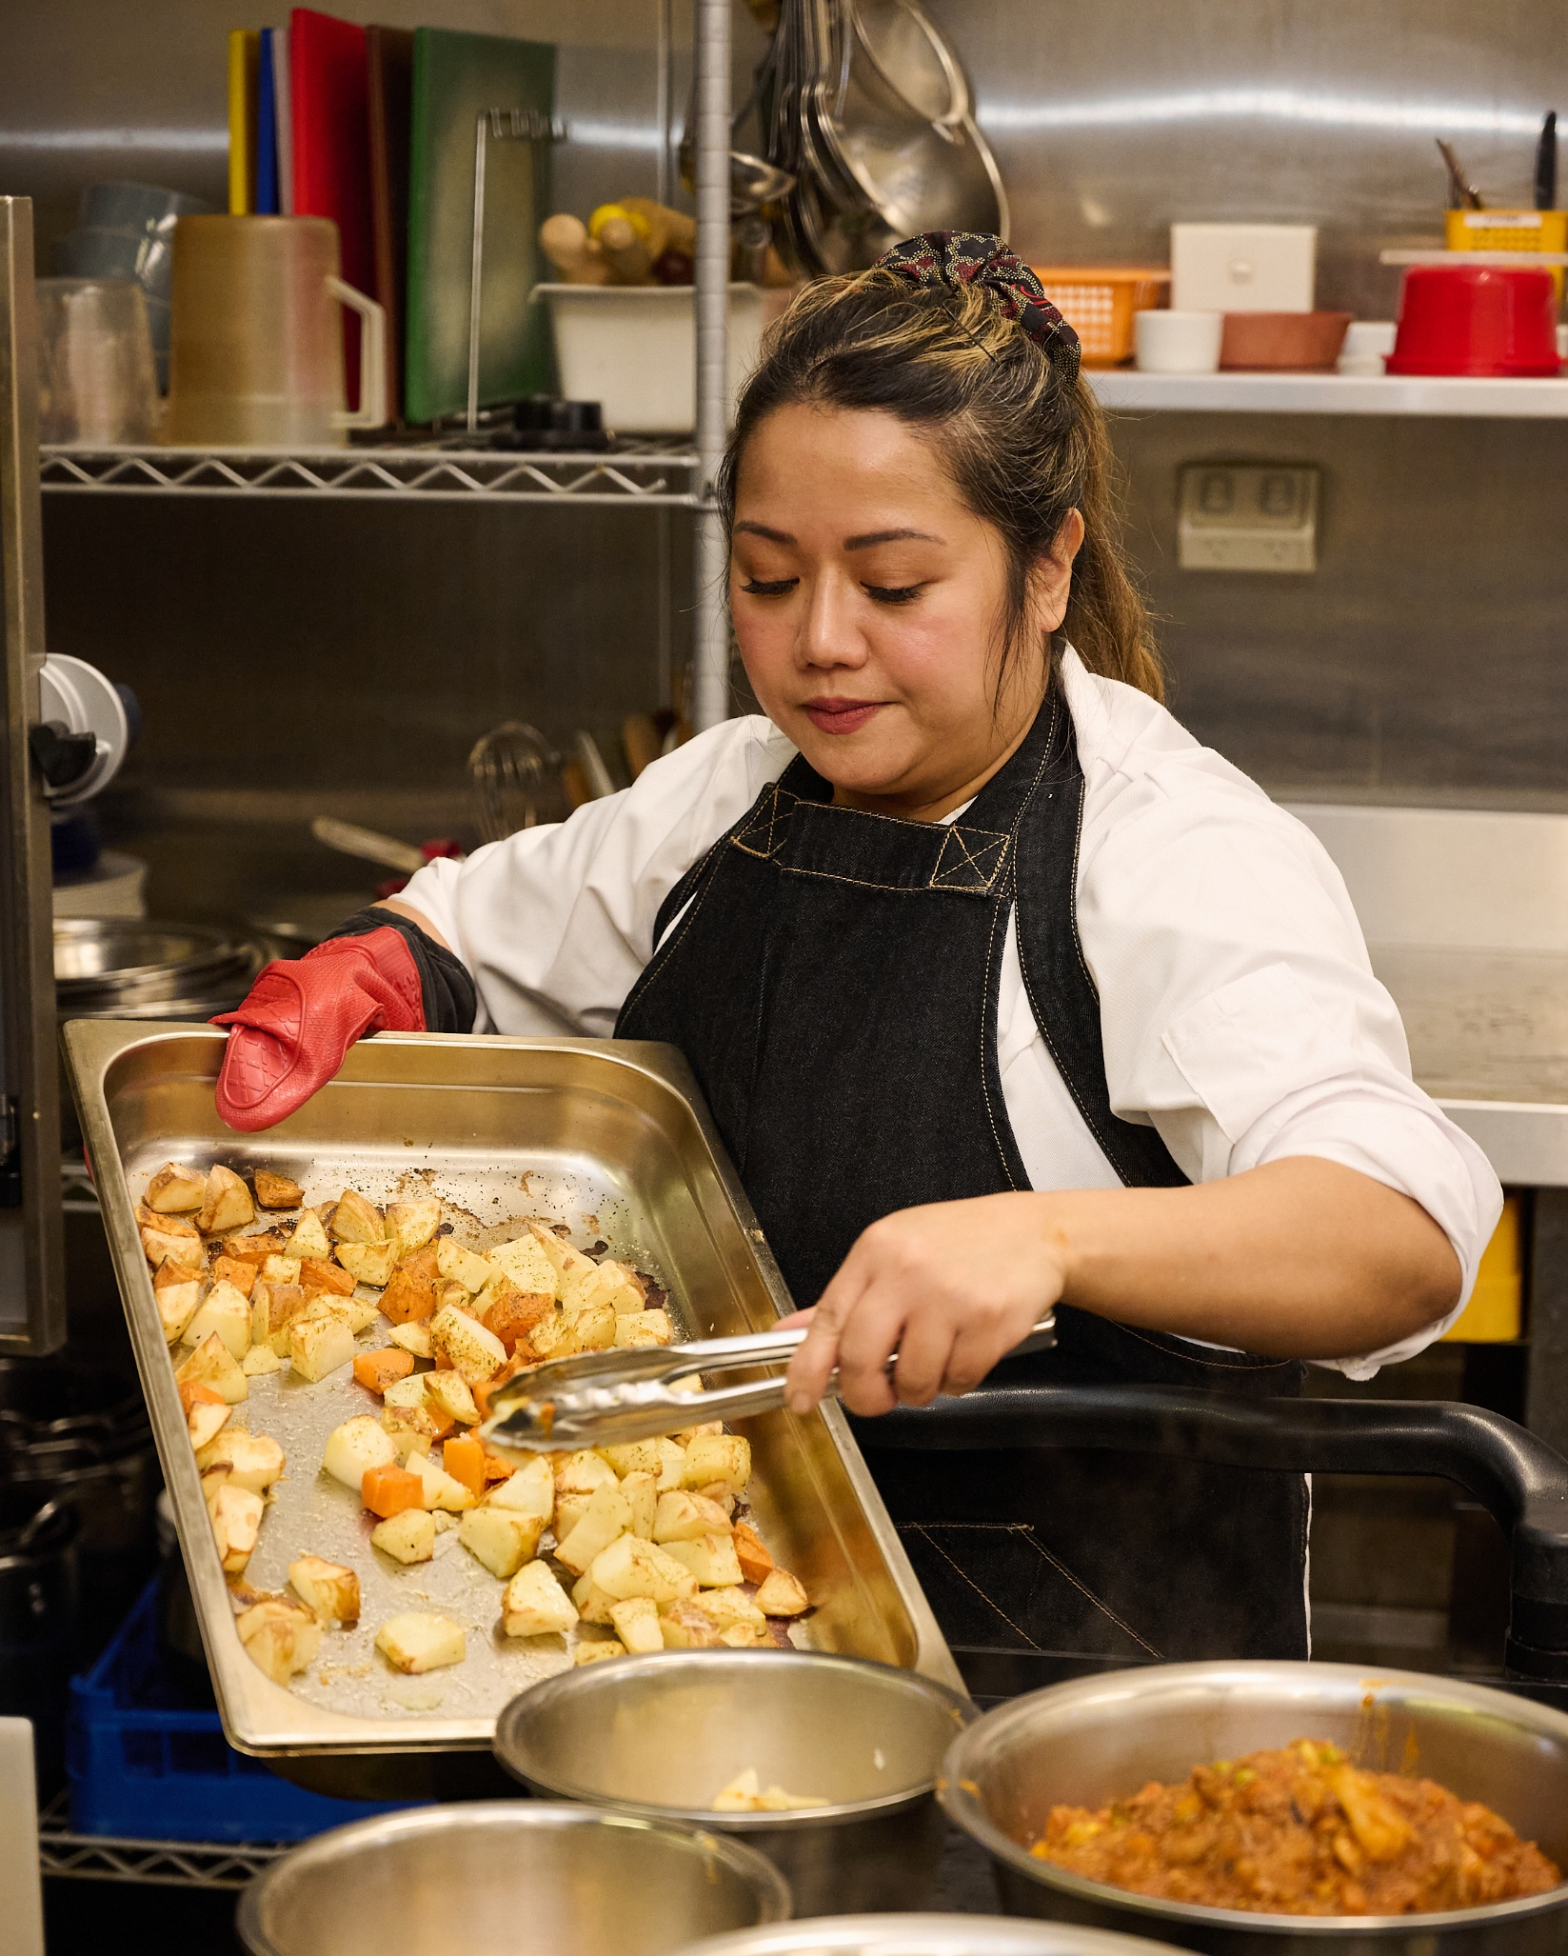
Discussion: Main dish and snack ideas
What are some items that you include on your menu that include:
Grain foods
Protein option (meat/meat alternative, fish, legumes or beans, dairy)
Vegetables
Can anyone share a new recipe or meal that has been successful on your menu?

Slide 12
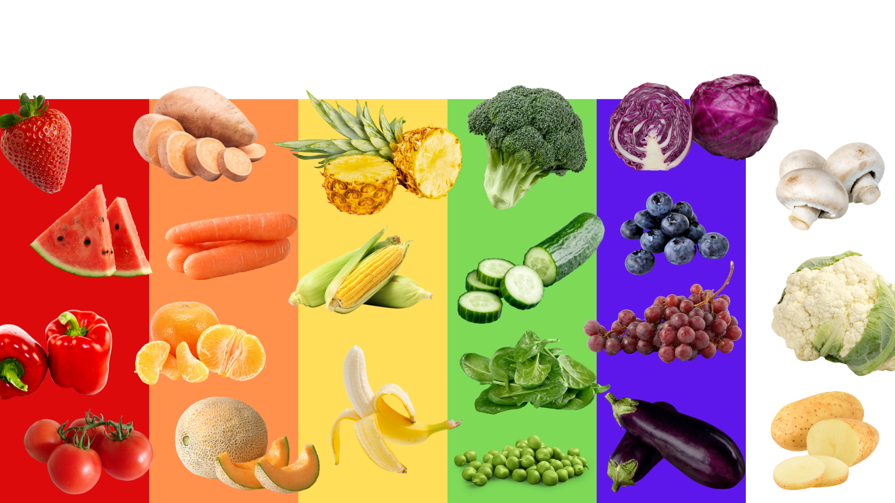
Discussion - Eat the rainbow

Slide 13
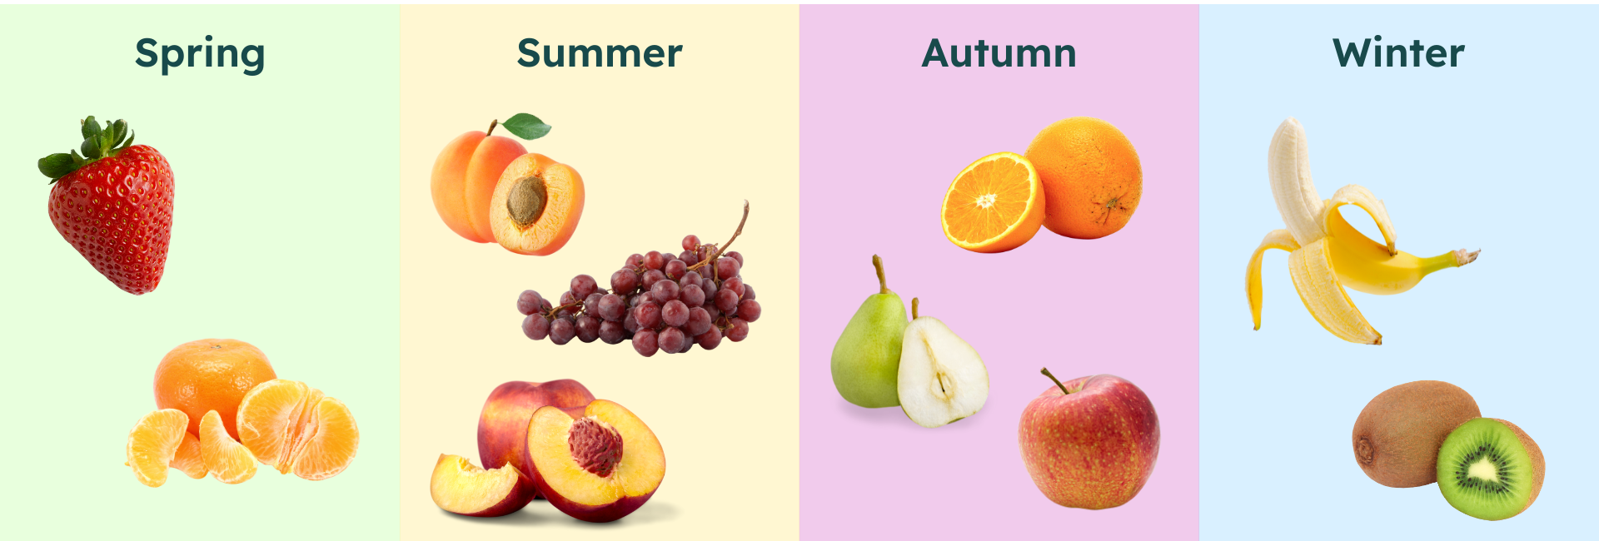
Discussion: Seasonal menus
Fresh
Tasty
More affordable

Slide 14
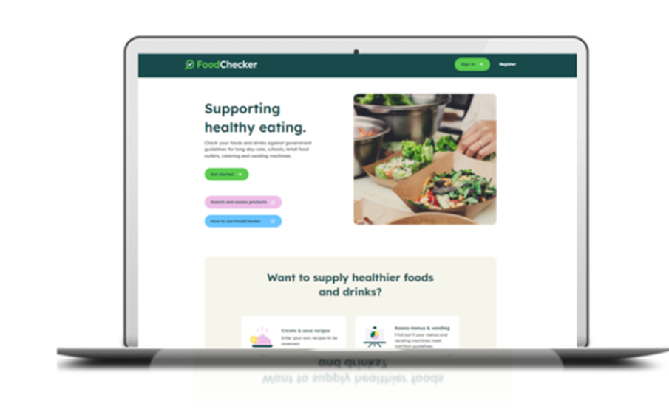

HEAS supports available
For more support:
Free training modules for cooks and educators
Food allergy and intolerance course and resources
Infoline via phone and email
FoodChecker, free online menu assessment tool
Website with resources, recipes and more!

Slide 15
Thank you!
This presentation was prepared by the Healthy Eating Advisory Service team.
heas@nnf.org.au
1300 22 52 88

